Slide 1
Memory
Nothing is ever lost to us, so long as we remember it
L.M. Montgomery, The Story Girl

Slide 2
Question 1 – how often will you write?
There are broadly two kinds of computer memory – RAM and ROM
ROM, while standing for Read Only Memory, isn’t NECESSARILY forever. There are four different kinds:
ROM
PROM
EPROM
EEPROM

Slide 3
ROM
Pressed in a factory, using a mask, just like a CPU
Great for “this will never, ever change and I need 10,000 of them”
Used to be used for game cartridges, kernel storage “back in the day”
Much faster than other storage media of the 70’s, 80’s, 90’s
Cheaper than RAM for many years

Slide 4
PROM (no, not the dance…)
Imagine a grid of fuses, at the chip level
A PROM programmer is a machine that burns out SOME of those fuses. Blown out fuses are “0” and intact fuses are “1”
You can’t reprogram a PROM (how would you replace the fuses?) – you write to it once, ever.
Great for low quantities

Slide 5
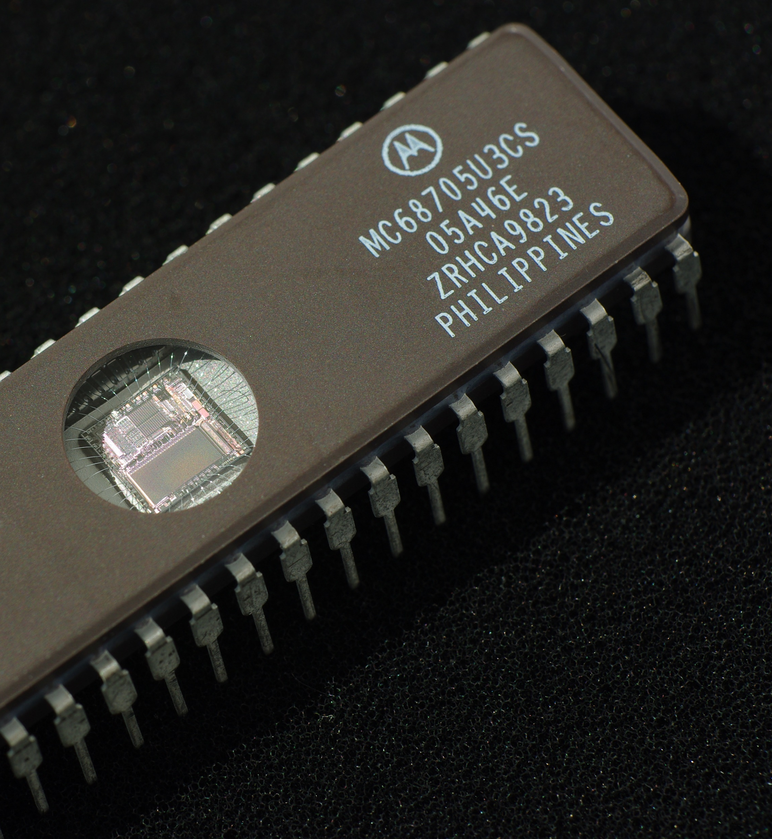
EPROM
Erasable Programmable Read Only Memory
Shining a UV light through the window erases
Great for developers to use to test their designs
Too expensive to use in production

Slide 6
EEPROM
Electrically Erasable Programable Read Only Memory
Originally, could be modified only one bit at a time; this process is slow and required a lot of power.
Flash is an example of an EEPROM

Slide 7
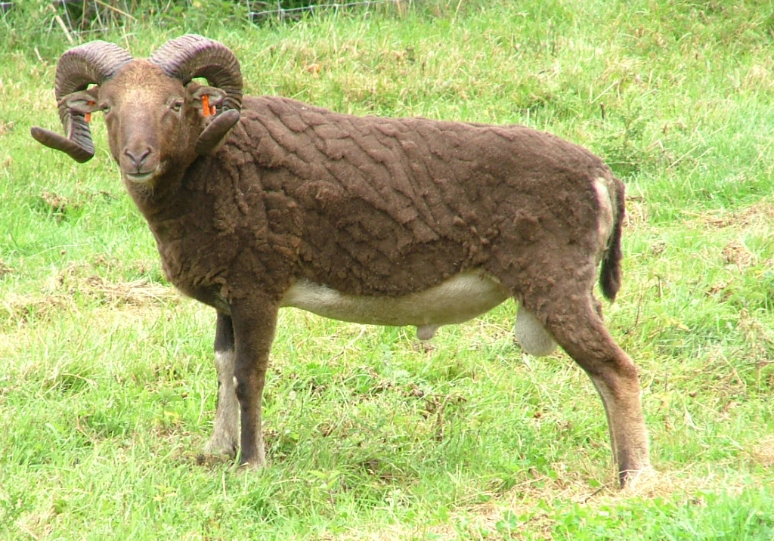

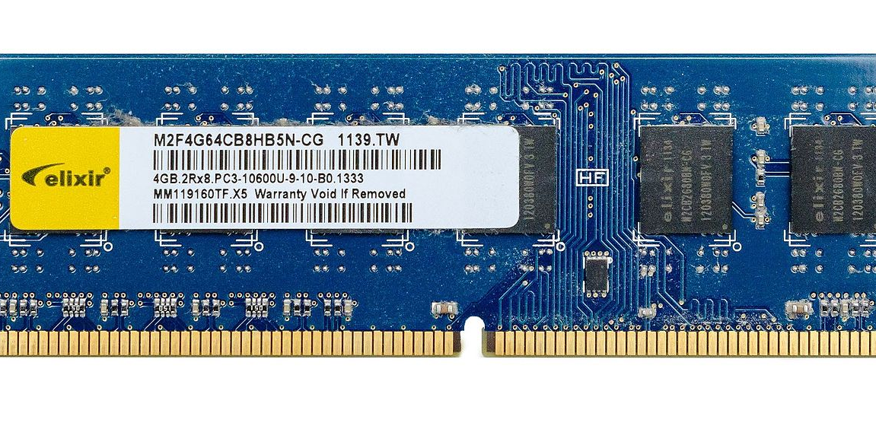
RAM

Slide 8
Only two different types…
DRAM (Dynamic)
SRAM (Static)
Made of capacitors (capacitor = battery fast to charge and discharge but can’t hold much)
Has a recharge cycle
CHEAP!
SLOW!
Low power/heat
Dense
Made of flip-flops (flip-flop = transistor)
No recharge cycle
Expensive
FAST
High power/heat
Sparse (large surface area/bit)

Slide 9
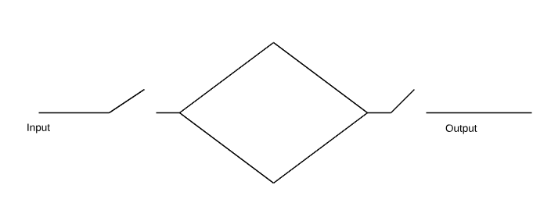

SRAM
How can we make memory?
What if we could “just” make the electricity go around in a circle until we needed it?

Slide 10
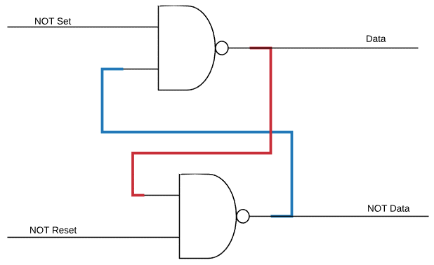
Flip Flops
While the previous slide (a.k.a. a space heater) won’t work, this will

Slide 11

WAT?

Slide 12

Remember NAND:
X | Y | NAND
0 | 0 | 1
0 | 1 | 1
1 | 0 | 1
1 | 1 | 0
S’ | R’ | D | D’ | Comment
1 | 1 | 0 | 1 | No change
1 | 1 | 1 | 0 | No change
0 | 1 | 1 | 0 | D is set
1 | 0 | 0 | 1 | D is cleared

Slide 13
Issues with SR Flip Flops
There are combinations of inputs that make no sense (set and reset both lowered)
The possibility of indeterminate states
Raise both R&S then lower them. The memory cell’s value is unknown

Slide 14
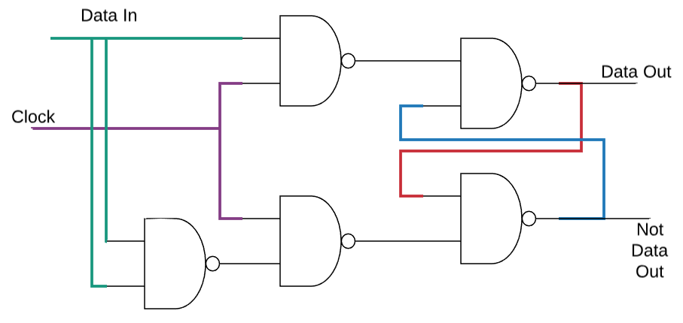
D Type Flip Flop
Button to set

Slide 15
Things to Notice
State only changes when the clock is set
No weird set/reset
5 gates instead of 2

Slide 16
OK, Great. Problem Solved, right?
There is one more problem that we have to solve.
Ripple.
What happens when I read from the memory in the middle of a clock cycle that is changing the memory?
I can get either of the values…

Slide 17
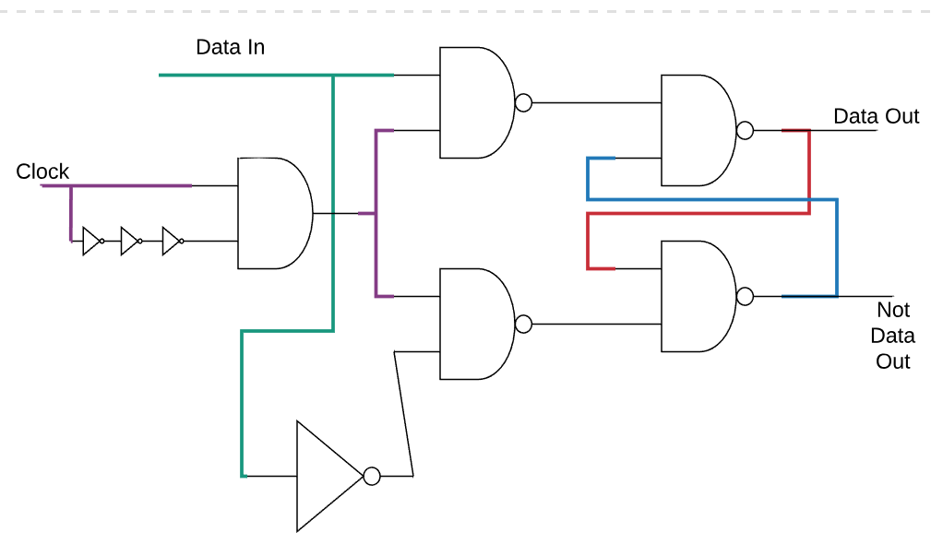
Edge Triggered D-Type Flip Flop
Triple not for the delay required for each not

Slide 18
Key Points about SRAM
The simple solution has some problems.
The more complete solution requires more gates.
SRAM is very fast and simple to interface with.
SRAM is also expensive and is mostly used in CPU registers and caches.
Sram can get bigger so accessing gets slower, as amount of sram increases

Slide 19

DRAM it Jim
I am a Doctor, not a Computer Scientist!

Slide 20
We started SRAM with this:
How can we make memory?
What if we could “just” make the electricity go around in a circle until we needed it?
How else could we make memory?

Slide 21
What if we “just” used a little battery to hold a charge rather than having it go in a circle?
That little battery is a capacitor.
Wait… that seems too simple. What’s the catch?
The catch is the organizational methodology to access a large quantity if memory.
Oh, and leakage…

Slide 22
Leakage
Capacitors aren’t perfect batteries. They lose charge over (short) time.
The loss is not 100% - it drains like a bucket with a leak.
The memory subsystem has to refresh the capacitors by reading and then re-writing them. This happens on a rolling schedule.
This happens outside of the CPU – the memory system has circuits for this. While this is happening, though, the CPU can’t access that bank.

Slide 23
Manufacturing Variation
DRAM typically updates every 64ms; this is done in staggered banks. While refreshing, the bank is unavailable.
Is every capacitor equally leaky? What if we measured and stored this? Then we could only refresh as necessary.
Further, when you read memory, you drain and refill the capacitors.
What if, instead of a rolling refresh, we ordered memory requests to fetch the cells most in need of refresh?
This is all ongoing research…

Slide 24
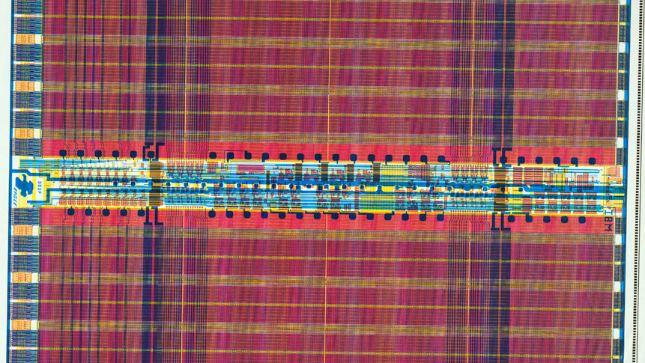
Memory Organization and Timing
And How it Relates to Building PCs

Slide 25

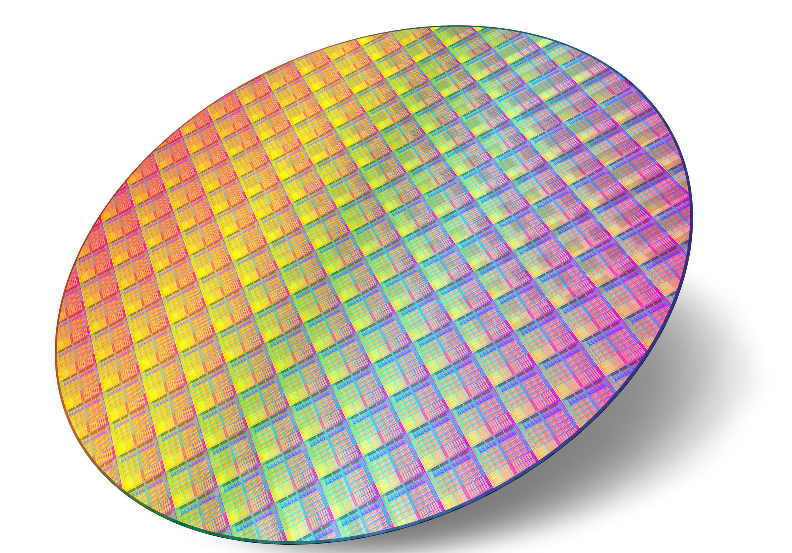
From the ground, up (literally)

Slide 26
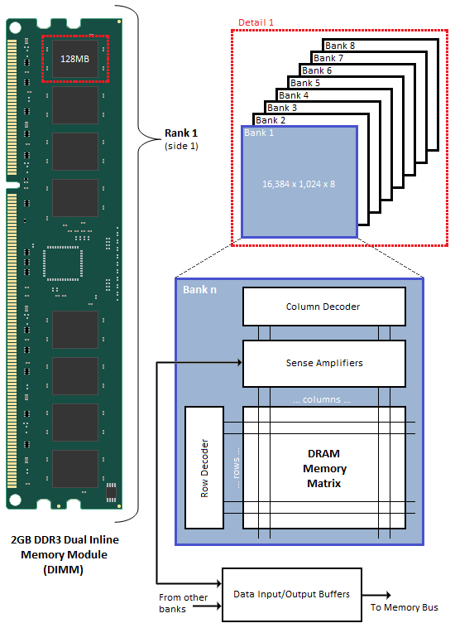
The CPU requests a single byte (for example) by address. The memory controller assigns, at start up, address ranges to each DIMM. The DIMM is hard wired to split addresses up by chip.
Each chip contains banks (grids), which have rows and columns. An address is converted to DIMM/chip/bank/row/column, by the hardware (memory controller and DIMM hardware) to get to a single byte.

Slide 27
Demultiplexers
You might wonder how we can take a binary address (say 1010 0101) and convert it to a single row or column line.
A demultiplexer takes N inputs and has 2^{N} outputs.
The row and column decoders shown on the previous slide are demultiplexers.

Slide 28
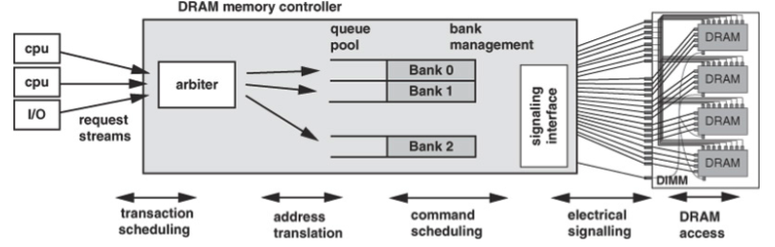

Slide 29
Banks
DRAM is divided into banks for a few reasons:
Refresh is by bank (we will talk about this later)
When we aren’t accessing a bank, we reduce the power to it – saves heat and power
Each bank can process a request (parallelism)

Slide 30
Each bank has to be opened (enabled); only one can be open at a time. A row is specified at the same time.
The time that this takes is called “tRCD” – Time Row Command.
All times are in clock cycles.
If a bank is already open, it must be closed. That time is “tRP” – Time Row Precharge.
Once this is completed, a column can be selected.
The time that this takes is called tCAS – Time Column Address Strobe.
Once the bank is open, reads and writes take only tCAS time.
The bank then needs to be closed (precharged); this can be combined with the last read/write
In the worst case, a memory access will require tRP + tRCD + tCAS
Buying memory, you will see a set of timing numbers, something like: 5 - 7 - 6: tCAS - tRCD - tRP

Slide 31
A question on Performance
Given what we just learned about memory performance, how can you optimize memory references?

Slide 32
Clocks
All (modern) memory runs on a clock, just like the CPU
A quartz crystal (often) is used to generate a sine wave of power from the constant DC electricity that the power supply provides.
Also like the CPU, we can’t just keep increasing the clock rate – the speed of light in copper over a distance is set.
But, what can we do?

Slide 33
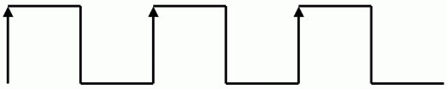
If you think about a clock in a computer, it is nothing more than a single wire containing a (square-ish)sine wave.

Slide 34
Double the Data Rate!
With better control over the timing of the signals, designers realized that they could send twice as much data using the same clock if they sent data both on the rising and the falling edges of the wave.
This lead to some confusion in the memory industry. In the old days, you could say “100mhz memory” and everyone understood what that meant.

Slide 35
A Kindly Word about Marketing
DDR memory was sold with two different numbers. These numbers are related but not obviously.
DDR-400 is 200mhz memory that is double data rate. When you transfer 8 bytes at a time (every chip is returning data simultaneously), you can transfer 3,200 MB/s. So DDR400 is also known as PC3200 or PC-3200.

Slide 36
Memory Controllers
As recently as 5 or 6 years ago, there was a separate chip, called the “northbridge” that handled high speed interfaces (GPU, memory, PCI-E) and their access from the CPU.
Modern architectures have moved away from this toward integrating the memory controller into the CPU
- Parallelism
- Less distance, cost
- Modularity wasn’t a huge benefit

Slide 37
What does the memory controller do (wherever it is)?
On startup, the memory controller queries the memory slots to find memory in the system.
The memory controller dynamically configures itself to route ranges of address blocks to memory slots.
The memory controller ensures that the memory gets refreshed and it can reorder memory accesses to increase performance.

Slide 38
Select Portions of the AM3 pinout
MA_CLK_H/L[7:0],MB_CLK_H/L[7:0] DRAM Differential Clock
MA[01]_CS_L[1:0],MB[01]_CS_L[1:0] DRAM Chip Selects
MA_CKE[1:0], MB_CKE[1:0] DRAM Clock Enable
MA_DQS_H/L[8:0],MB_DQS_H/L[8:0] DRAM Differential Data Strobe
MA_DATA[63:0],MB_DATA[63:0] DRAM Interface Data Bus
MA_DM[8:0], MB_DM[8:0] DRAM Data Mask Bits
MA_CHECK[7:0],MB_CHECK[7:0] DRAM Interface ECC Check Bits
MA_RAS_L, MB_RAS_L DRAM Row Address Strobe
MA_CAS_L, MB_CAS_L DRAM Column Address Strobe
MA_WE_L, MB_WE_L DRAM Write Enable
MA_ADD[15:0],MB_ADD[15:0] DRAM Column/Row Address
MA_BANK[2:0],MB_BANK[2:0] DRAM Bank Address

Slide 39
Server (mostly) memory
Errors happen.
Sometimes a cosmic ray hits your memory and flips a bit (seriously!).
On our desktops and laptops, we grumble about Microsoft, Apple or Linux, restart the app/computer and move on with our day.
What happens if this happens on the Blackboard server at 11:59PM?

Slide 40
Parity
Parity, overall, is a technique to determine that a data transfer is correct. It is used in telecommunications as well as in memory.
A ninth bit is added to each byte. The hardware designers decide to use either even or odd parity (it doesn’t matter). If even parity is used, the 8 bits of data PLUS the parity bit must be an even number of bits. So if the data is 0101 1010, parity is 0; if the data is 0000 0001, parity is 1.
If a single bit of data is changed, parity will detect it (but can’t fix it).
What are the downsides to parity?

Slide 41
ECC
ECC or Error Correcting Code memory uses additional bits and some advanced algorithms (Hamming Code or Triple Modular Redundancy) to not only detect errors, but to fix single bit errors.
Often, the cost of ECC memory (1/2 more for one example) outweighs the value for many organizations/systems.

Slide 42
Multiported memory
It is possible to create memory that can be read from by more than one system at a time. Later, when we are talking about CPUs that can do more than one thing at a time, “why” will become more obvious.
How do we handle 2 or more systems trying to write to the same memory at the same time? By preventing it in hardware.
Some memory time shares the memory. This works if memory access time is shorter than a clock cycle.

Slide 43
Performance in 2018
The fastest ram I could find for sale is DDR4-4600.
The I/O bus clock speed is 2.3ghz.
The internal clock is ~600mhz.
Peak transfer is 36.8 GB/s
If an average x64 instruction is 4 bytes long (varies)
A 4ghz processor requires 16GB/second/core just for code.
What if I have 4 or 8 or 32 cores?

Slide 44
Performance Trends
Over the last 20 years, memory capacity has grown by > 100 X
Over the last 20 years, memory bandwidth has grown by > 20 X
And leveled off in recent years…
Over the last 20 years, memory latency has improved by 1.3 X
And has been flat for a long time…
Memory access consumes 1,000X more power than addition!

